Slide 1


Slide 2

National University of Modern Languages,
Islamabad
NUML E PAYMENT
Pay Fee On One Click

Slide 3




Group Members
Abdul Hanan Nawaz
M. Hamza
M. Bakht Jamal
Freelance Data Engineer
Web Developer
@NUML E Payment
Front End Developer @Msberater

Slide 4
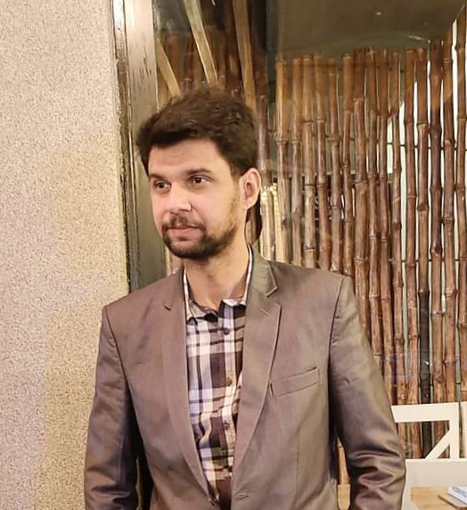
Supervisor
Mr. Mohsin Abbas
Lecturer @NUML

Slide 5
Outline
1
2
3
4
5
Introduction
Existing System
Problem Descrip.
Project Objective
Proposed System
6
7
8
9
10
Methodology
Project Scope
Feasibility Study
Solution App. Area
Tools & Tech
11
12
Milestones
Reference

Slide 6
Introduction
NUML e-payment is an online payment system that enables students, faculty, and staff to pay for various university-related expenses through a secure electronic platform.
Traditional fee payment methods can be time-consuming, inconvenient, and often prone to errors, which can result in delays and inconvenience for both students and universities.
To address these challenges, educational institutions are turning to modern fee payment systems that offer a range of benefits, including convenience, efficiency, and accuracy. These systems provide a secure online platform for students to make payments from anywhere at any time.

Slide 7

Existing System
Here are the list of some Existing System:
CUST
UCP
LUMS
UOG

Slide 8
Comparative Analysis
Sr. # | Features | CUST | UCP | LUMS | UOG | Proposed System
1 | Tuition Challan
2 | Generate Challans
3 | Print Challan
4 | Account Book
5 | Instalments
6 | Pay Online
7 | Data Analytics

Slide 9
8 | View Record
9 | Verification
10 | Seize Degree
11 | Request Letter
12 | Department and their Representators
13 | View Department Data
14 | Print Receipt
15 | Campus Admin

Slide 10
16 | Generate Reports
17 | Download Report
18 | Campus addition
19 | Fee Structure
20 | Download Fee Structure

Slide 11

Problem Description
The problem with traditional fee payment methods is that they can be time-consuming and often require students to physically visit the payment centers, causing inconvenience and delays in processing. Additionally, manual payment processing is prone to human errors, resulting in inaccurate record keeping and reconciliation issues. This can lead to payment discrepancies and misunderstandings between the students and the institution.

Slide 12
Proposed System
The proposed NUML E Payment System application is designed to provide a more efficient and streamlined mechanism for processing tuition fee payments.
By eliminating the need for manual processing, it will help to reduce errors and delays in payment processing, and provide students with a more convenient and user-friendly payment option. With the ability to track and store payment records securely.
The NUML E Payment System application will offer greater transparency and accountability, making it an essential tool for the university's financial management.
Ultimately, this innovative payment system will enable NUML to optimize its payment processing procedures, increase efficiency, and enhance the overall student experience.

Slide 13
Features
1
2
3
Tuition Challan
Generate Challan
Print Challan
4
5
6
Account Book
Instalments
Pay Online

Slide 14
Features
7
8
9
Data Analytics
View Record
Verification
10
11
12
Seize Degree
Request Letter
Department and Their Representators

Slide 15
Features
13
14
15
16
View Department Data
Print Receipt
Campus Admin
Generate Reports
17
18
19
20
Download Reports
Campus Addition
Fee Structure
Download Fee Structure

Slide 16
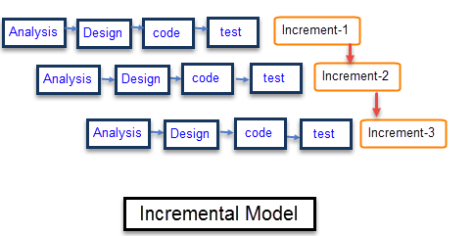
Methodology
Agile Iterative Model
Agile method combines both incremental and iterative methodology. It is iterative because it plans for the work of one iteration to be improved upon in subsequent iterations. It is incremental because completed work is delivered throughout the project.
During a development “iteration” where we build several features some may be iterating to improve, modify or remove existing functionality, while others may be incrementally adding new functionality.

Slide 17


The proposed system will provide much more functionalities than the existing systems like generating challans and printing them.
These systems provide a secure online platform for students to make payments from anywhere at any time, with multiple payment options available to suit individual preferences.
The systems also generate payment receipts and confirmation emails, providing students with proof of payment and enabling accurate record-keeping for universities.
Project Scope

Slide 18

Feasibility Study
The API policies that we use for Payment Integration have changed.
API server breakdowns due to technical issues or scheduled maintenance
Internet Connection

Slide 19

Solution Application Area
We are focusing on E Payments. With the help of our proposed system.
Fee can be paid easily and without waiting in queues for Long.

Slide 20

Tools & Technology
Mobile App
Website
Backend
Database
Java
Html, CSS, Bootstrap, JS
C#, Asp . net MVC
MSSQL Server
ETL Pipeline
Data Analytics Dashboard
Python
Tableau

Slide 21


















NUML E PAYMENT Milestone
1-April-2024
15-Feburary-2024
Documentation
Final Testing
1-August-2023
1-December-2023
15-July-2023
Design & Testing
Development
30-May-2023
Prototyping and UI Design
Architecture
Design
7-May-2023
7-May-2023
Requirements gathering & Analysis
Proposal ond Presentation

Slide 22
[1] Capital University of Science and Technology, Islamabad. Available at: https://portal.cust.pk/stdportal/login.do
(Accessed: 1 May, 2023)
[2] University of Central Punjab, Lahore. Available at: https://portal.ucp.edu.pk/login?returnUrl=%2F
(Accessed: 2 May, 2023)
[3] Lahore University of Management Sciences, Lahore. Available at: https://lums.edu.pk/lums_member
(Accessed: 6 May, 2023)
[4] University of Gujrat, Hafiz Hayat Campus, Gujrat. Available at: https://cms.uog.edu.pk/Login/login_view
(Accessed: 6 May, 2023)
References

Slide 23

Any Questions?

Slide 24

NUML E PAYMENT
May 7, 2023
Thank you!
Have a great day ahead.
https://www.hanannawaz.com

